Slide 1


MAVEN ANALYTICS DATASETS ON SALES @SQL ANALYSIS

Slide 2
Share visualizations (and any applicable pivot tables, code etc.) on LinkedIn and mention @Maven Analytics. We would love to see your work and give our thoughts!
Recommended Analysis
Are there any noticeable sales trends over time?
Which are the best and worst selling products?
Can you identify any key customers?
Are shipping costs consistent across providers?

Slide 3
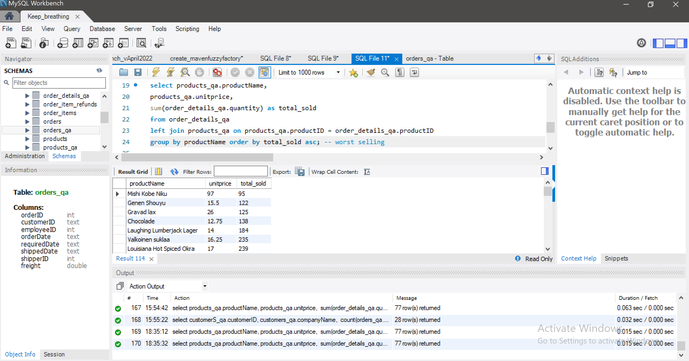
WORST SELLING
PRODUCTS

Slide 4
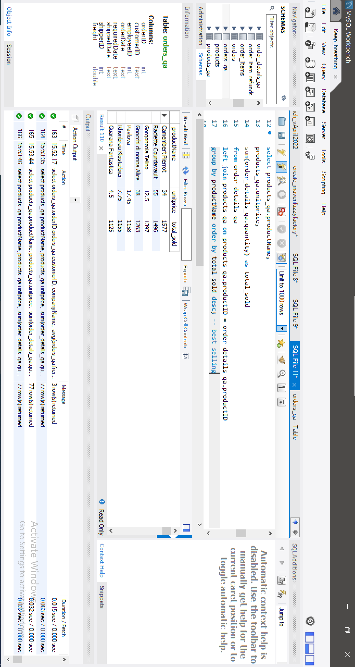
BEST SELLING
PRODUCTS

Slide 5
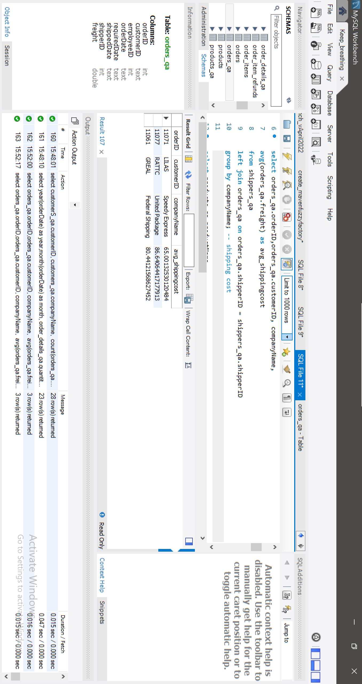
SHIPPING COST

Slide 6
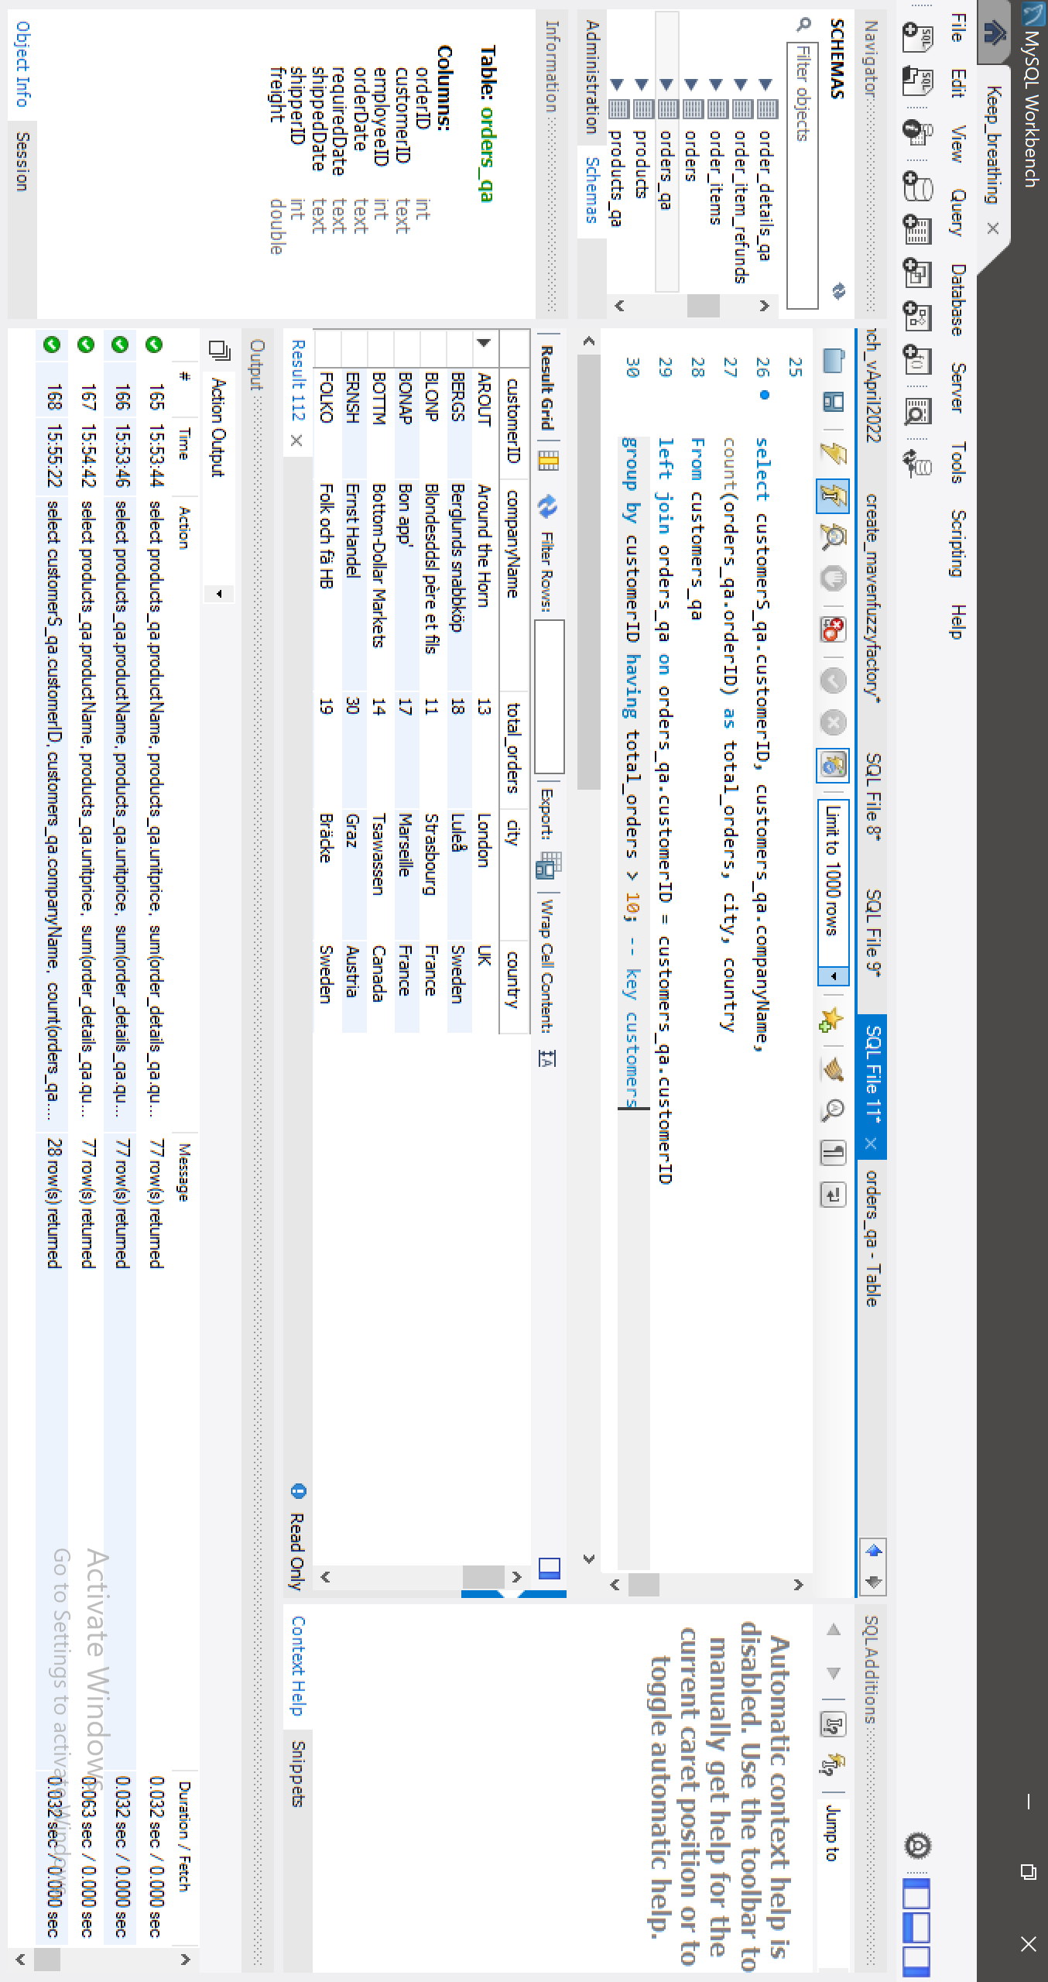
KEY CUSTOMERS

Slide 7
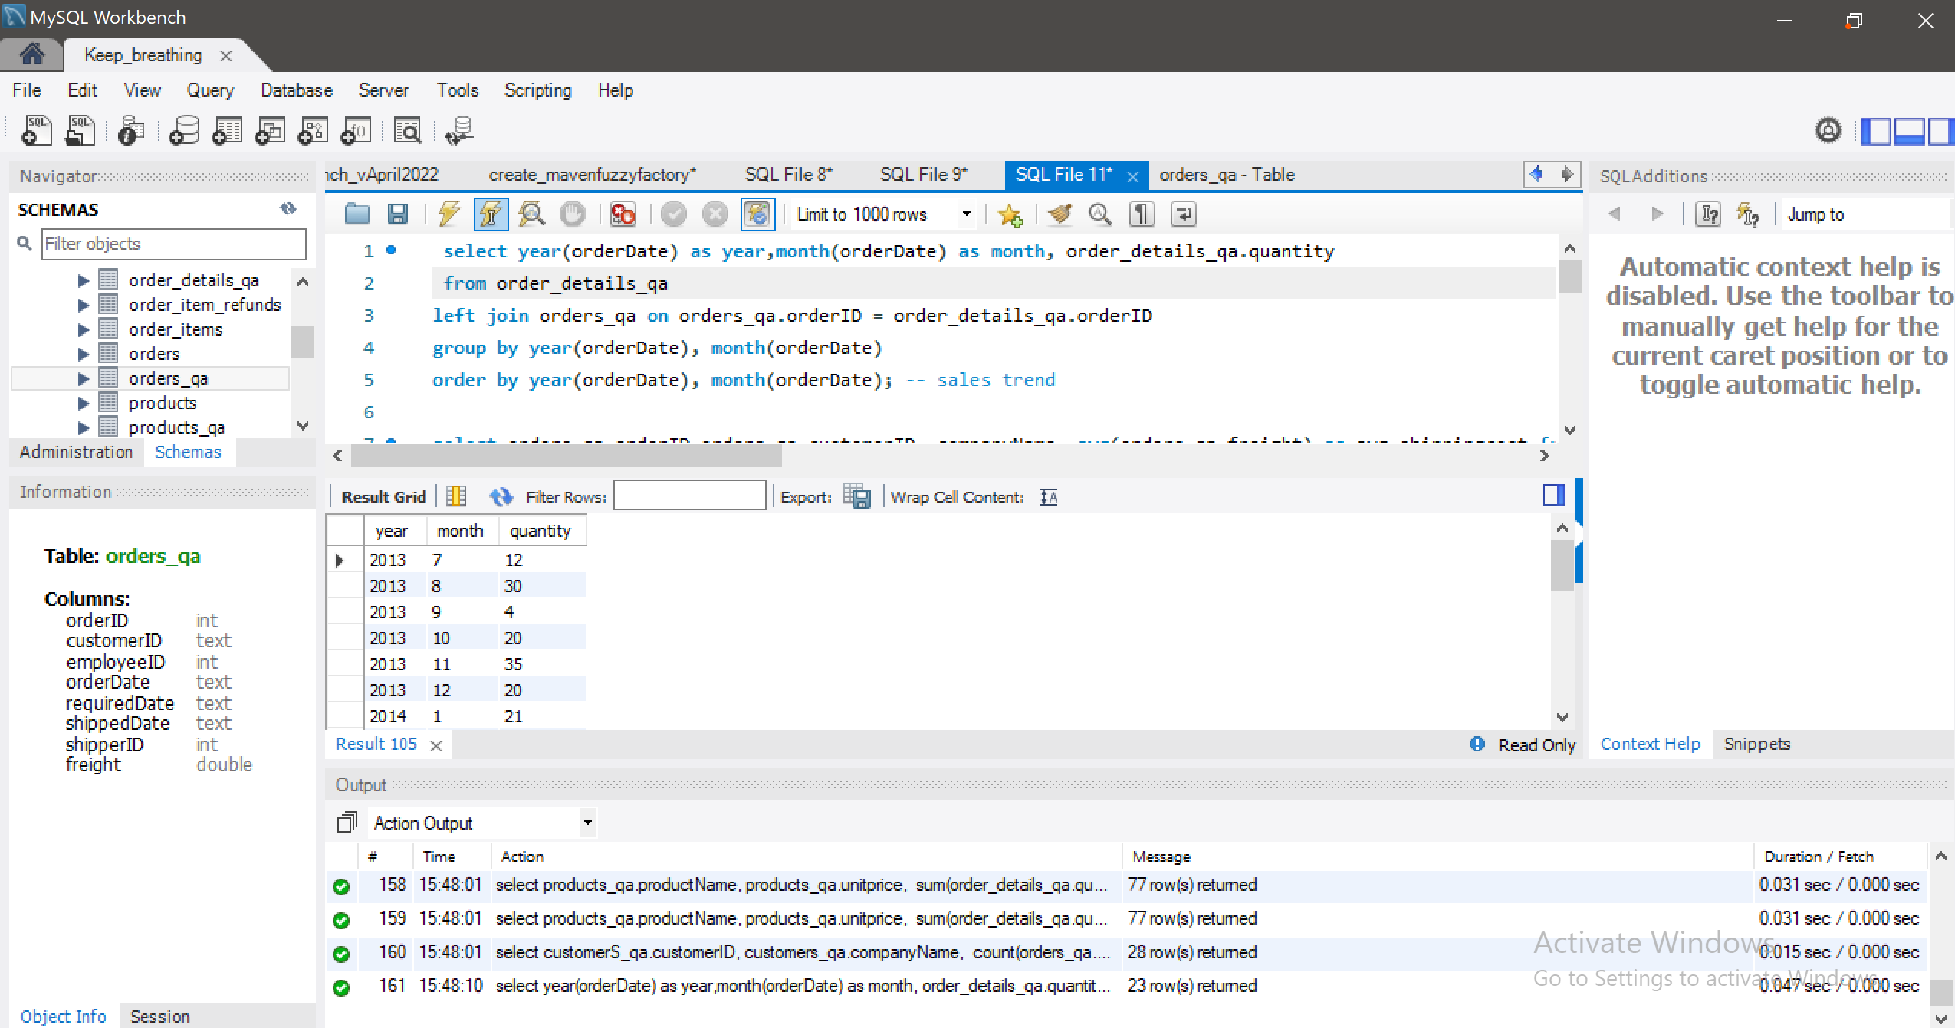
SALES TREND

Slide 8
To receive more updates, make sure hit the follow button to like and comment: linkedin.Com/in/abiodun-o
Thank you for staying till the end

